Slide 1

Bonfire, Firework and Halloween Safety

Slide 2
Bonfires and Fireworks
Fireworks are not toys and hurt people every year
Bonfires can easily get out of control
Both bonfires and fireworks reach extremely hot temperatures
Greater Manchester Fire and Rescue Service’s advice is to attend an organised event, but if you are going to have fireworks and bonfires in the garden here is some safety advice for you and your adults to follow, please listen carefully.

Slide 3






Bonfire Safety
Remember…
Always…
Never…
Only adults should light bonfires
Keep some buckets of water nearby
Never throw fireworks or aerosols into a bonfire
Stand 5m away (at least one car’s length)
Check that no animals are hiding in the bonfire before lighting
Never wear Halloween costumes around a bonfire

Slide 4



Firework Safety
Remember…
Always…
Never…
Only adults should light fireworks
Keep a bucket of water nearby at all times
Never return to a firework once it has been lit
To stand well back when watching fireworks
Keep pets indoors
Never put fireworks in pockets and never throw them
Please always follow the firework code!

Slide 5

Sparkler Safety
Remember…
Always…
Never…
Sparklers are not toys, they burn 10 times hotter than boiling water
Light sparklers one at a time, wear gloves and avoid loose clothes
Never give sparklers to a child under five
To put used sparklers into a bucket of water or sand
Hold sparklers away from the body and at arm's length
Never run with sparklers

Slide 6

Halloween Safety
Remember…
Always…
Never…
To be seen – carry a torch, wear brightly coloured costumes or reflective tape
Trick or treat at well lit and decorated houses only
Never trick or treat alone – always with an adult
To avoid the street – walk on pavements and look both ways before crossing the road
Buy costumes with a CE mark on them
Never play near lit flames, such as candles

Slide 7
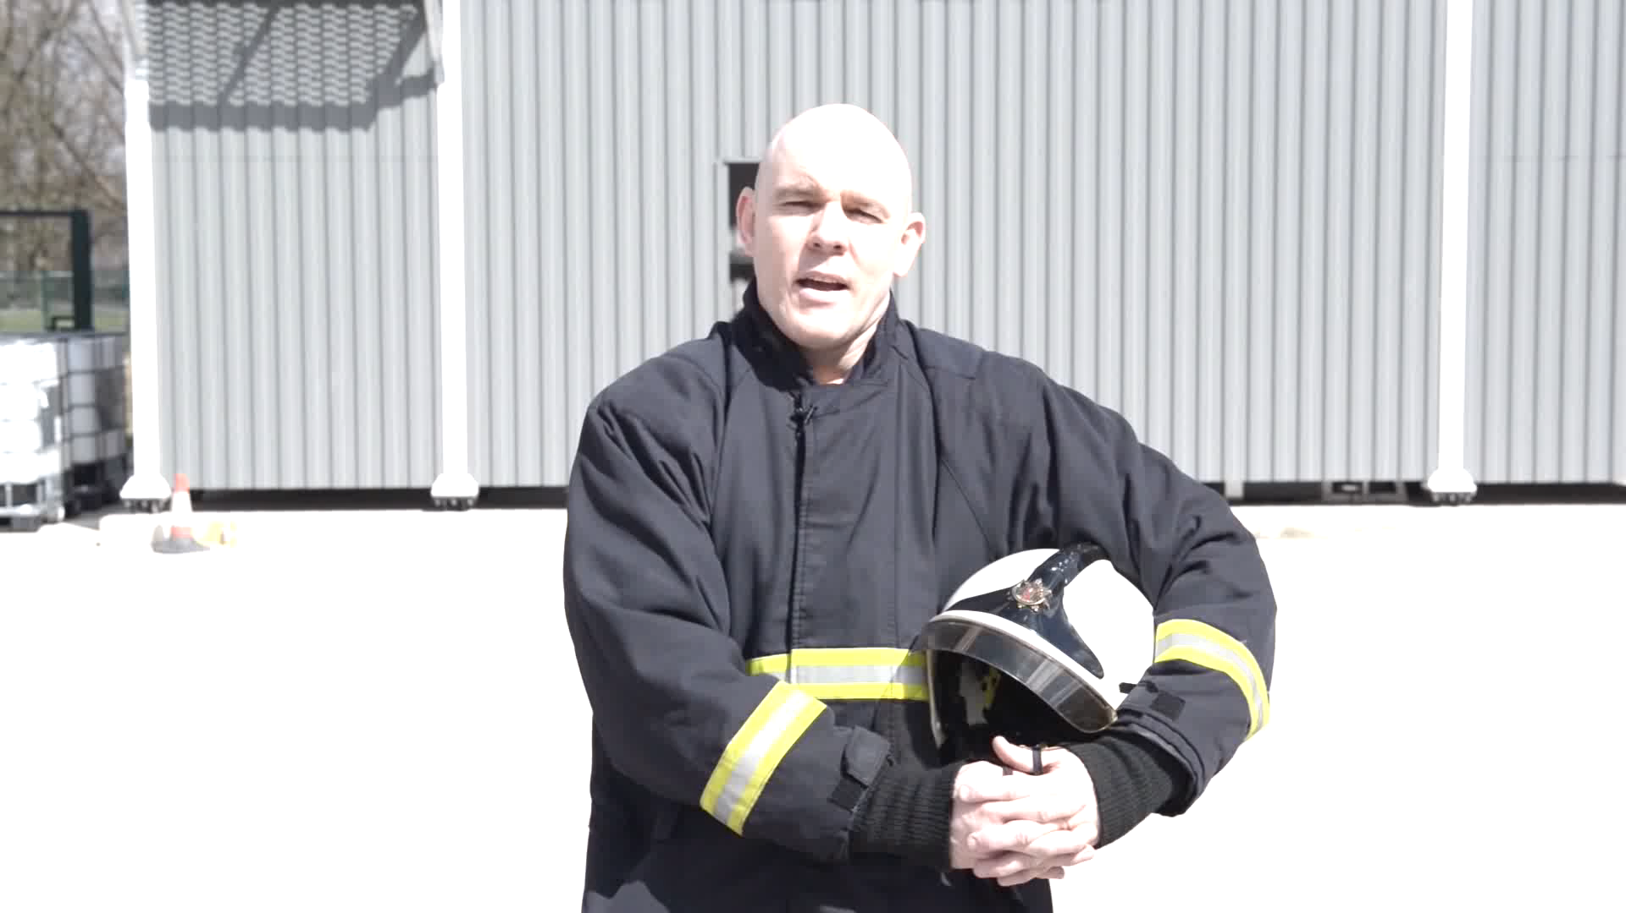

stop drop and roll
Notes:
YouTube link for Stop Drop and Roll! Video https://www.youtube.com/watch?v=O2iAO2651o8
Subtitles for Stop Drop and Roll! Video
Hello children, my name's Steve and I'm a
firefighter and I'm here to talk to you
today about what you should do if your
clothes catch on fire. It's really
important that we get this information
out because often people don't
understand how simple and easy it is to stop
drop and roll. With me today, I've got our
mascot brigade dog, Cracker, who's
been highly trained over many months.
He's been through a rigorous process
getting to the point today where you can
Come out and give us some assistance to
represent our brigade.
Okay Cracker, we're going to go to the
school now and I want you on your best
behaviour. Okay we've now arrived at the
school and we're going to show the
children how to stop drop and roll.
Are you ready Cracker? Come on then.
The end.

Slide 8
Knowledge Check
What were the things we wanted you to remember?
What were the things you will always do?
What will you never do?
What did we ask you to tell your adults at home to read, which can be found on our website?
What should you do if your clothing catches fire?

Slide 9
Have a safe time this
Halloween and
Bonfire Season!
www.manchesterfire.gov.uk/your-safety/campaigns

