Slide 1
Stay Safe this Summer!

Slide 2
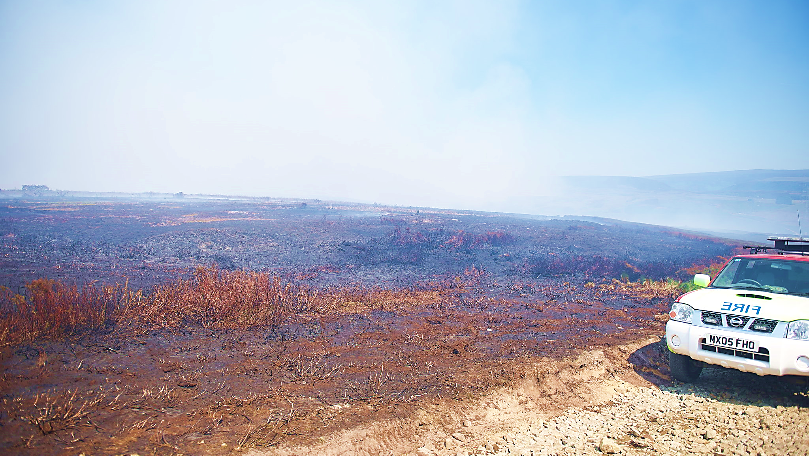
Grassfires and Moorland Fires

Slide 3
What causes Grassfires and Moorland Fires?

Slide 4
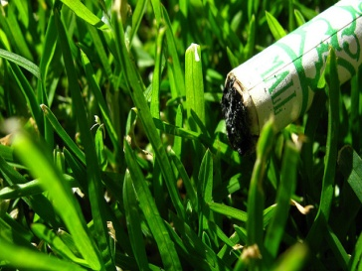
Cigarettes

Slide 5
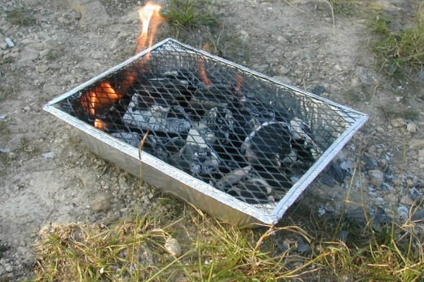
Barbeques

Slide 6
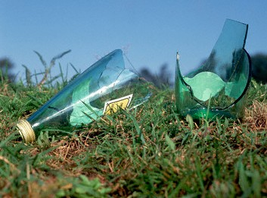
Litter

Slide 7
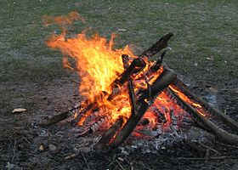
Camp Fires

Slide 8
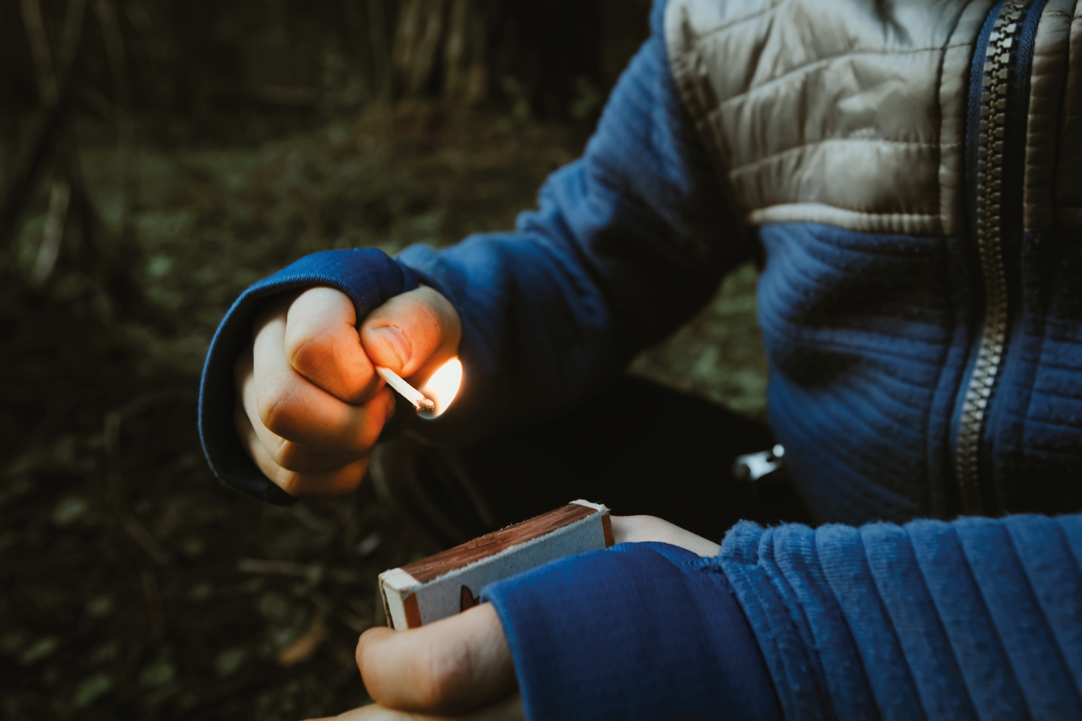
Anti-Social Behaviour

Slide 9
Preventing Grassfires and Moorland Fires
Grown ups should make sure cigarettes have been put out properly
Take litter home with you
Never light a barbeque on the grass
Never light camp fires in open grassland
Never start a fire on purpose

Slide 10
Please Stay Safe this Summer!
Visit www.safe4summer.com

