Slide 1
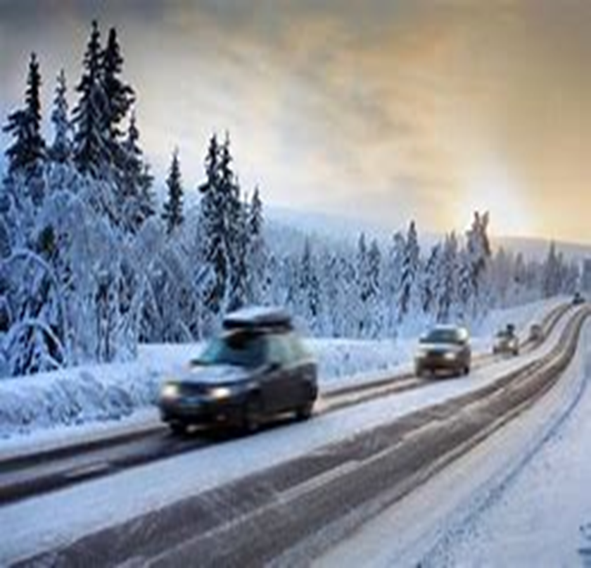
Road Safety
Winter Driving

Slide 2
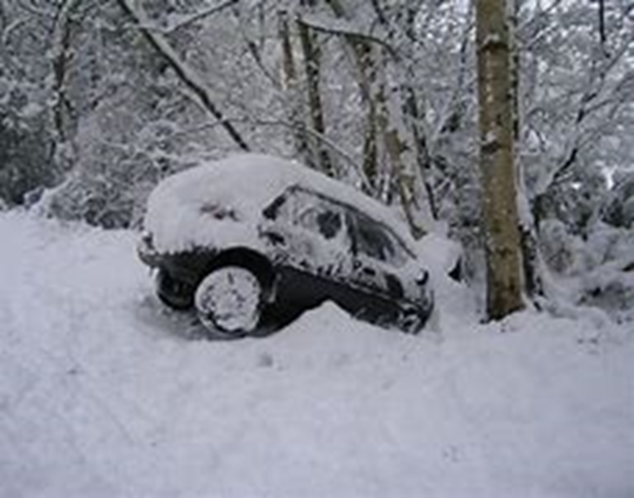
Driving in the Winter
Adverse weather and longer periods of darkness
Heavy snow and floods.
Different weather conditions
This means that we need to adapt the way we drive to the conditions.
In very bad conditions, avoid driving completely, unless you absolutely have to make the journey and driving is the only option.

Slide 3
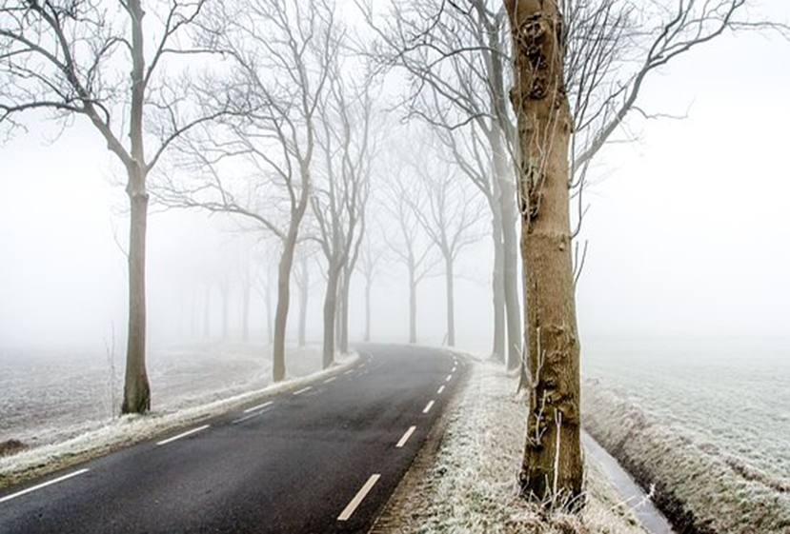
Before setting off
Allow extra time
Plan routes around major roads
Try to get up at least 10 minutes early to give you time to de-ice the car.
Wear comfortable, dry shoes for driving so your feet don't slip on the pedals.
Check fuel levels
Clear all windows using a scraper and de-icer and wait until the windscreen's fully demisted.
If you drive an automatic, check the handbook, some have a winter mode or recommend selecting ‘2’ in slippery conditions.

Slide 4
What else can you do?
Check the weather
Are you fit to drive? Have you slept well? Are you on medication that could affect your driving?
Remember that snow and ice can increase the normal breaking distance for your vehicle.
Leave plenty of space between you and other vehicles
Wrap up warm, take a flask containing hot drinks and blankets.
Charge your phone or have a charger in the car for emergencies.
Be prepared with a “Snow Kit”

Slide 5
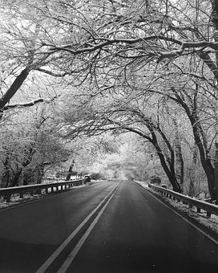
Car Maintenance
Don't let air out of your tyres to get more grip, it doesn't work, and it’s unsafe.
Only use snow chains if there’s enough snow to prevent damage to the road.
Think about getting winter tyres or all-season tyres, these are made from a special rubber that gives better grip in cold, wet conditions.
Look after batteries and electrics.
Top up your antifreeze in cold weather.

Slide 6
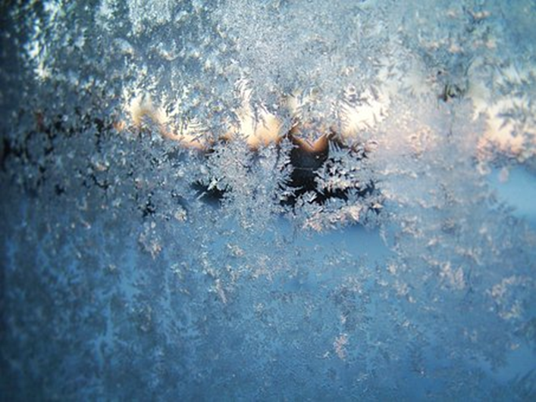
Make your car visible
Poor visibility
Check lights are working and are clean
If the roads are really mucky, you might have to clean your lights after every trip.
Keep number plates clean, to avoid fines.
If you have to clear snow, don’t forget the lights front and back.
You must use headlights when visibility is seriously reduced.
If you use fog lights, remember to switch them off when visibility improves so they don’t dazzle other drivers or obscure your brake lights.

Slide 7
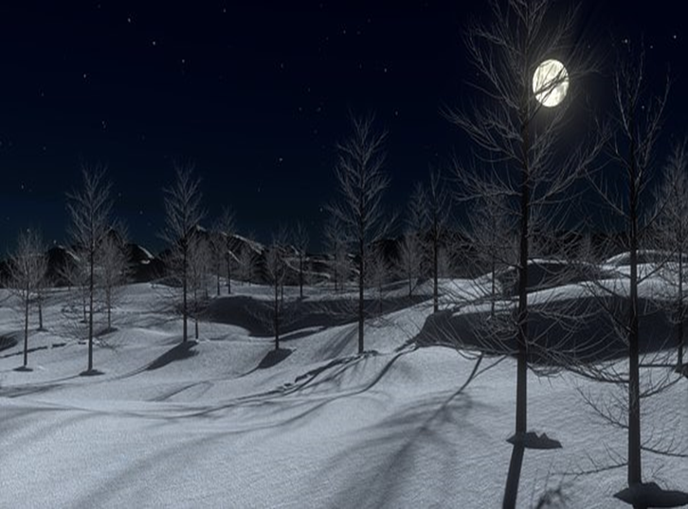
Driving on Winter Roads
Pull away in second gear, easing your foot off the clutch gently to avoid wheel spin. If you have to use your brakes, apply them gently.
Driving uphill, leave plenty of room between other cars or wait until it’s clear so you don’t have to stop part way up. Keep a constant speed and try to avoid having to change gear on the hill.
Driving downhill, slow down before the hill, use a low gear and try to avoid braking.
Leave as much room as you can after the car in front.

Slide 8
If you get stuck in the snow or ice
Straighten the steering and clear the snow from the wheels. Put a sack or old rug in front of the driving wheels to give the tyres some grip.
Keep the windscreen and other windows clear of dirt and snow to avoid a fine.
Clear snow from the roof, it can fall onto the windscreen and block your view.
Air-con demists the screen faster and reduces condensation.
Replace worn or damaged wiper blades.
Don’t leave your wipers on auto when you park up if there’s a risk of frost. If the blades freeze to the screen, you could damage the blades or wiper motor when you turn the ignition on.
Use a suitable additive in your screen wash to reduce
the chance of it freezing.

Slide 9
If you’re completely stuck…
If you do end up stuck in heavy snow, follow these tips to try and get your car moving again.
Keep calm.
Don't spin your tyres or move your wheels from side to side, you'll end up burying yourself deeper or overworking your clutch and engine.
Use a snow shovel to dig out the snow that is under your tyres. If you don't have one then use whatever comes to hand. If the car's exhaust is covered in snow, dig this out too as this could cause your engine to cut out.
Use snow chains or snow socks , place them over your tyres, taking care to follow the instructions.

Slide 10
If you’re completely stuck continued..
If you can get all passengers out of the car, then this can help to reduce weight and potentially make getting out easier. If you've got children in the car, then leaving them in their seats is advisable so they don't get cold.
Having no luck at all, then call your breakdown service and wait. Easier said than done, but try not to drain your fuel by sitting with the engine running - wrap up with blankets instead.
If you're stuck in a remote location, don't be tempted to try and walk to find help, stay with your vehicle and wait for help to arrive, or try and flag down a vehicle. Even in the UK where winters can be milder than other countries, weather can soon get worse, leaving you exposed to the elements.
If you get stuck on a road, deploy your red hazard triangle (if you have one) and wear a high vis vest. If other motorists or larger vehicles are managing to get by, then you'll give them a better warning if you're blocking the way.

Slide 11
Stay Safe this Winter Any Questions?

