Slide 1
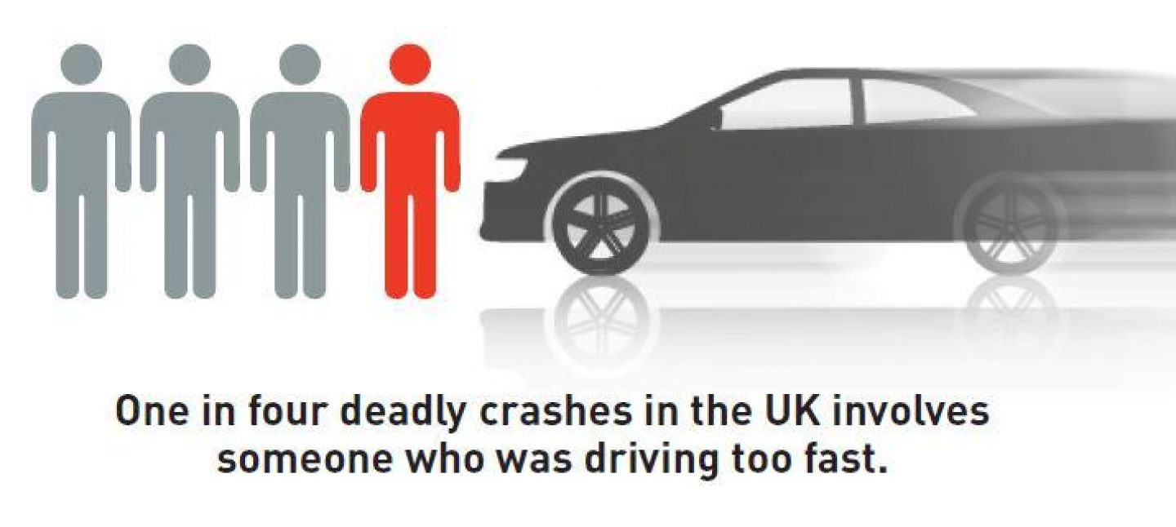
Road Safety
Speeding

Slide 2

‘Mistakes’ – Speeding (Film)
Some viewers may find this distressing.
Notes:
Transcript is available on the lesson plan

Slide 3
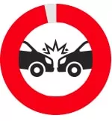
Speed Limits Are Not Targets
Speed limits are limits, not targets.
When a car crashes, it’s the amount of kinetic energy that the car has which determines the force of impact. Kinetic energy is the energy of motion. Small increases in speed lead to much higher increases in kinetic energy.
When you’re driving, it’s hard to perceive that a slight increase in speed is really so damaging..
Crashes at higher speeds cause more severe injuries and deaths.

Slide 4

Rural Roads Are Not Racetracks
Narrow, bendy roads often lack pavements or cycle paths and are unsuited to high speeds.
Rural roads pose high risks, accounting for well over half of all fatal crashes.
Speed is often a major factor in rural road crashes. A study showed a 10% increase in average speed results in a 30% increase in fatal and serious crashes.
The most common crash types on rural roads are collisions at intersections, head-on collisions and running off the road.

Slide 5



Stopping Distances
A vehicle travelling at 20mph would stop in time to avoid a child running out three car-lengths in front. The same vehicle travelling at 25mph would not be able to stop in time, and would hit the child at 18mph. This is roughly the same impact as a child falling from an upstairs window.
Driving is unpredictable and if something unexpected happens on the road ahead, such as a child stepping out from between parked cars, it is a driver’s speed that will determine whether they can stop in time and, if they can’t stop, how hard they will hit.
In adverse weather, such as icy roads stopping distance increases by up to 10 times.

Slide 6
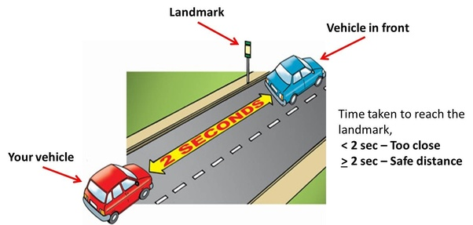
The Two Second Rule
The two-second rule is a rule of thumb by which a driver may maintain a safe trailing distance at any speed. The rule is that a driver should ideally stay at least two seconds behind any vehicle that is directly in front of his or her vehicle.
Allow at least a two-second gap between you and the vehicle in front on roads carrying faster-moving traffic and in tunnels where visibility is reduced.
The gap should be at least doubled on wet roads and increased still further on icy roads

Slide 7
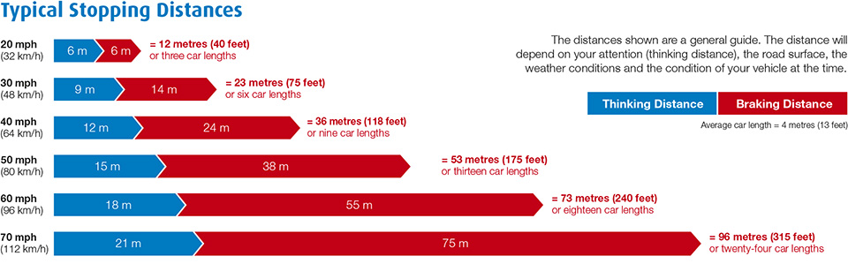
Stopping Distances

Slide 8
Safe Speeds Saves Lives
Driving at a safe speed reduces the risk of road death and injury
A pedestrian hit at 30mph has a 1 in 5 chance of being killed.
Every day, road crashes cause devastation to individuals, families and communities.
With someone injured on a UK road every four minutes, and vehicle speed playing a part in every crash.
Research has found that many young men are overconfident and take more risks.

Slide 9

Slower Driving is Safer
The faster a vehicle is travelling, the longer it takes to stop.
The faster we drive, the greater our risk of crashing. A crash at 30mph has twice the energy and destructive potential of a crash at 20mph.
The greater the impact speed, the greater the chance of death.
Where traffic is slow, more people choose to walk or cycle. 20mph is an appropriate maximum speed in places where people live.

Slide 10
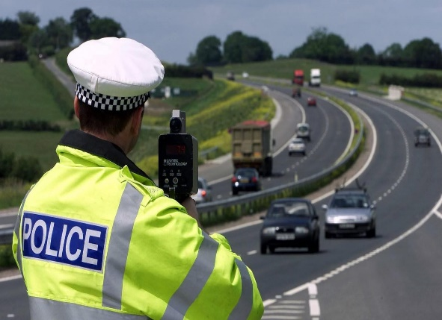
Speeding Drivers
Expect To Be caught
Safe road users comply with road rules and share responsibility for the safety of everyone who uses roads.
Most road deaths and injuries are caused by unsafe driver behaviour, often because drivers are going too fast for road conditions.
Investment in roads policing and a comprehensive speed enforcement programme is essential to catch speeding drivers and deter people from speeding.

Slide 11
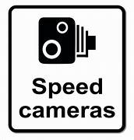
Speeding Penalties
The minimum penalty for speeding is a £100 fine and 3 penalty points added to your licence.
You could be disqualified from driving if you build up 12 or more penalty points within a period of 3 years.
New drivers, still within 2 years of passing their driving test, will have their diving licence revoked (withdrawn), if they build up 6 or more penalty points.
Please remember to drive safely, to protect yourself and others. Thank you.

Slide 12
Thank You
Any Questions ?
Speeding

