Slide 1
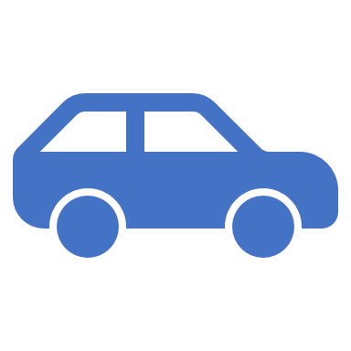
Road Safety
Seatbelts

Slide 2
Seat belts
The Law States
You must wear a seat belt if one is fitted in the seat you’re using and there are only a few exceptions.
You’re also only allowed one person in each seat fitted with a seat belt.
You can be fined up to £500 if you don’t wear a seat belt when you’re supposed to.

Slide 3
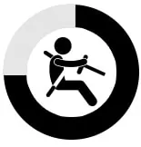
Seat belts
The main reason to wear a seatbelt is that it’s a safety precaution that prevents you from…
Getting killed by the force of the airbag opening.
Hitting the dashboard with your head during an accident.
Tumbling with your vehicle in case it flips over and starts rolling
Being ejected out of your vehicle in a crash.

Slide 4
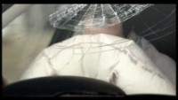
Film: Richard didn’t want to die
Notes:
Transcript is available on the lesson plan

Slide 5
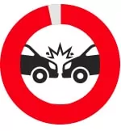
Seat belts and Children
Your children must.
Be in the correct car seat for their height or weight until they reach 135 centimetres tall or their 12th birthday, whichever is first.
Wearing a seat belt if they’re 12 or 13 years old, or younger and over 135cm tall.
You can be fined up to £500 if a child under 14 isn’t in the correct car seat or wearing a seat belt while you’re driving.

Slide 6

Seat belts
Children and Teenagers
Children and teenagers think that seatbelts are uncomfortable and awkward.
They believe that they would be depriving themselves of comfort and style by wearing seat belts.
They also believe that they are invincible and will never be involved in an accident.
Keep everyone safe, wear seatbelts

Slide 7
Seat belts
We always recommend that you wear a seatbelt where fitted, however there are some exemptions to this…..
Discuss with group…

Slide 8

If your vehicle doesn’t have seat belts
If your vehicle doesn’t have seat belts, for example it’s a classic car, you aren’t allowed to carry any children under 3 years old in it.
Children over 3 are only allowed to sit in the back seats.
These rules only apply if your vehicle was originally made without seat belts.

Slide 9
Seat belts
Wearing a seat belt while pregnant.
You must wear a seat belt if you’re pregnant, unless your doctor says you don’t have to for medical reasons.
Wearing a seat belt if you’re disabled.
You must wear a seat belt if you’re a disabled driver or passenger, unless you don’t have to for medical reasons. You may need to adapt your vehicle.
Carrying pets in vehicles.
Animals must be suitably restrained to prevent injury.

Slide 10
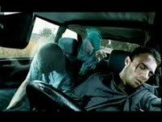
Heaven can wait, buckle up
Notes:
Transcript is available on the lesson plan

Slide 11

Seat belts
Please remember
Seat belts provide safety to everyone in the vehicle, other motorists and pedestrians.
Seat belt keeps you in your seat, not thrown through the windscreen, or thrown loose in the vehicle.
Airbags are designed to help keep you in place, along with your seat belt. If you are not wearing it, then the airbag system is ineffective.
You may receiving a fine for not wearing one.
Seat belts reduce the risks serious injuries and death.
Not wearing a seat belt could affect your insurance.

Slide 12
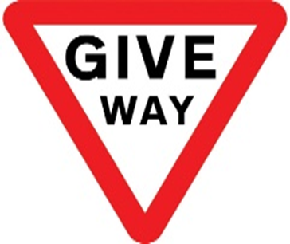

Thank You
Any Questions?
Seat belts

