Slide 1

KS3 (Year 8) School Resources

Slide 2

Hi, everyone! Today, we are going to talk about:
Fire Safety in the Home
Smoke alarms
Bedtime routines
Escape Plans

Slide 3

What might start a fire in your home?
Notes:
Full link to What might start a fire in your home YouTube video https://www.youtube.com/watch?v=W13uGoe76S8

Slide 4
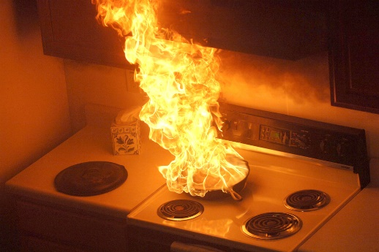
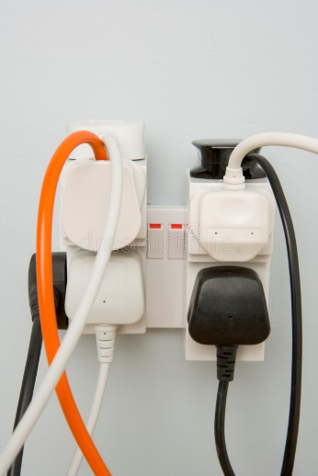
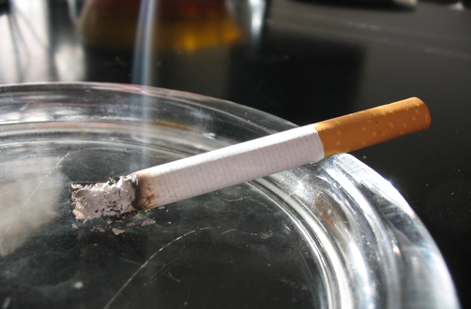
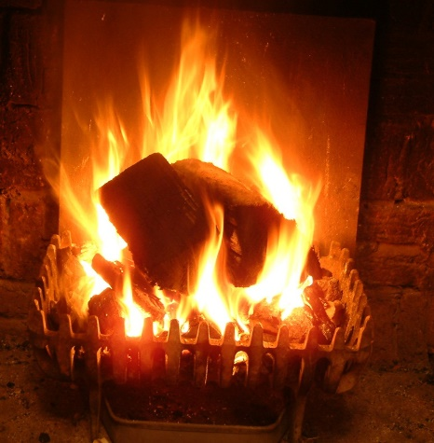
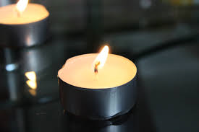
What might start a fire in your home?
Cooking
Electrical
Smoking
Fires & Heaters
Candles

Slide 5
Hazard spotting - See how many hazards you can spot!

Slide 6
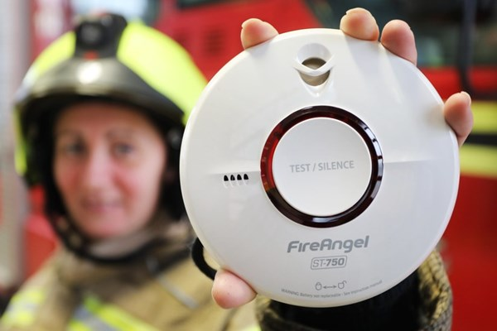
Smoke Detection
What is a smoke alarm?
Does your home have a working smoke alarm on each floor?
Did you know, you should test all your smoke alarms once a week to make sure they are working, by pressing the button in the middle until it beeps?

Slide 7

Bedtime routine
Put candles and cigarettes out.
Check your cooker is turned off.
Turn fires and heaters off an put up fireguards.
Make sure exits are kept clear.
Turn off the washing machine, dishwasher and tumble dryer.
Turn off and unplug electrical appliances unless they are designed to be left on, like your freezer.
Keep door and window keys in a safe place, away from the door itself, but where you would be able to reach them on your escape route. Tell members of your household where they are.
Close inside doors at night to stop the fire from spreading.
Take your mobile phone to bed with you, in case of emergencies.

Slide 8

Escape Planning
Make an escape plan that everyone in the household understands.
In the event of a fire get everyone together if possible. Escape through your nearest exit, if it is safe to do so.
Get out, stay out and call 999.

Slide 9

What to do if your escape is blocked
Get everybody into a safe room, preferably with a window.
Shut the door and put bedding etc around the bottom of the door to block out the smoke.
Call 999.
Only try and escape through a window if you have no other option, your escape route is blocked and you’re on the ground or first floor (under 3 meters in height). If you’re higher up wait to be rescued by Firefighters.

Slide 10
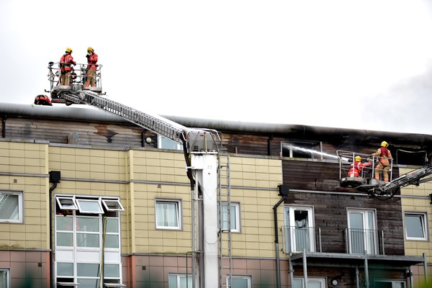
How to escape from a block of flats
Everyone in your home must know the fire plan for your building and where fire alarms and fire exits are.
You should plan and practise an escape route with everyone in your home.
Make sure everyone knows where to find door and window keys.
Do not use lifts, if you can go down the stairs.
If you’re on the ground floor only, you may be able to escape through a window.
If your escape route is blocked or full of smoke or fire, return to your flat and call 999 so firefighters know where you are and can give you help over the phone.

Slide 11

Questions to recap…
What are the 5 main causes of fires in the home?
How often should you test your smoke alarms?
What can we do to have a good bedtime routine?
If you hear the smoke alarm or there is a fire, how should you escape?
What if the fire is blocking your usual exits?
What number do you call in an emergency?

Slide 12
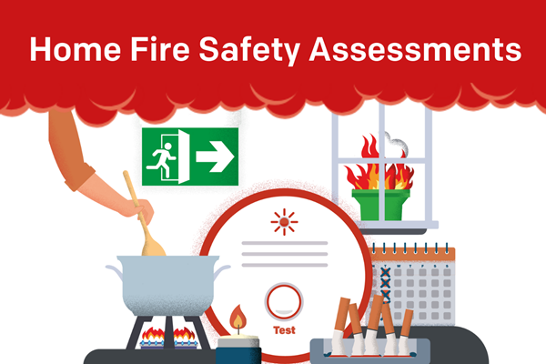
Any Questions?
Thank you, for more fire safety information or for information about
Home Fire Safety Assessments please visit: www.manchesterfire.gov.uk

