Slide 1

KS1 (Year 2) School Resources

Slide 2
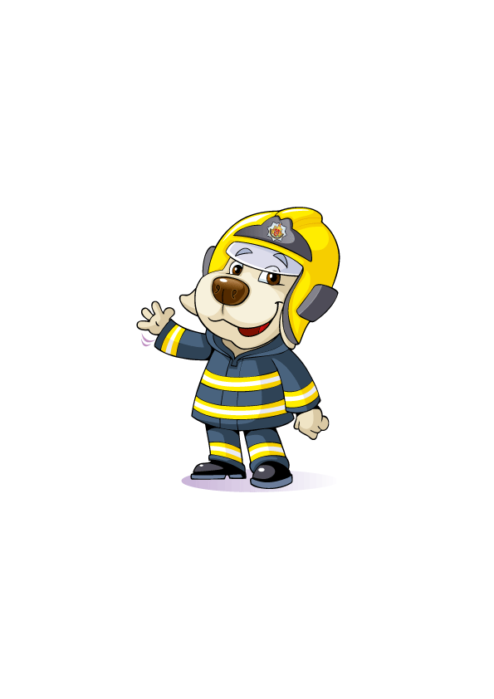
Hello everyone!
Meet Cracker the Fire Dog
Today, we are going to talk about;
Staying safe from fire at home
The dangers of playing with fire
Smoke alarms and escape plans
Calling 999

Slide 3
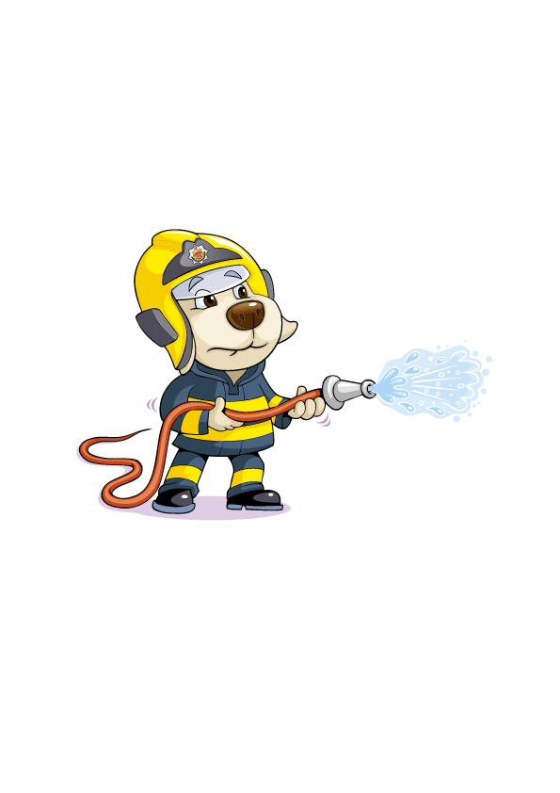
What might start a fire in your home?

Slide 4

Let me introduce you to my friend Frances the Firefly

Slide 5

Francis firefly video
Notes:
Full link to Francis firefly video YouTube https://youtu.be/mmflkVzAIeE Auto generated captions

Slide 6
Never play with matches
At the beginning of the video, what made Frances sad?
What did Cocky Roach give to Frances to use?
What happened to Frances and the village when she lit the match?
What should you do if you find matches or lighters?

Slide 7
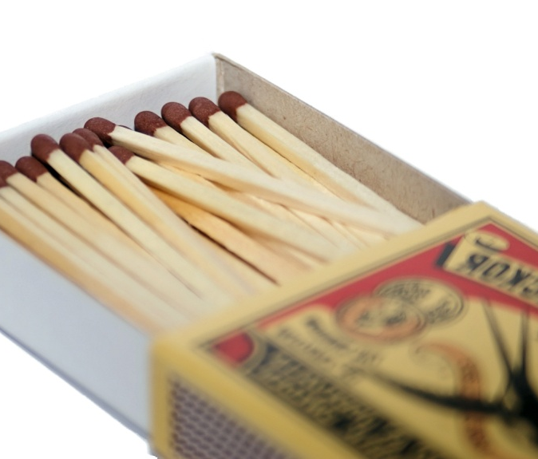
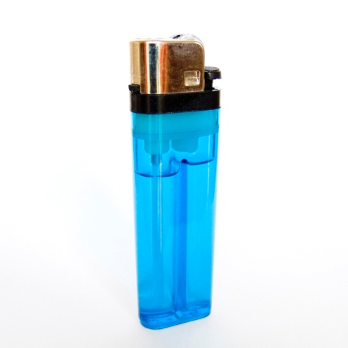
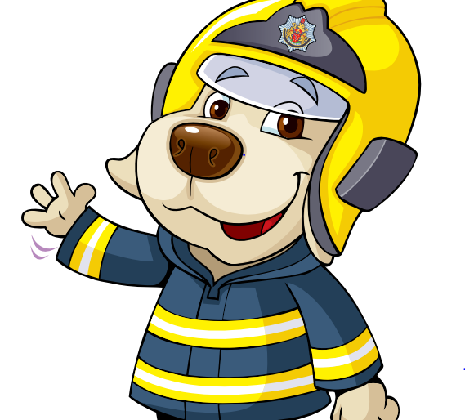
The Firefighter’s Poem
Matches, lighters never touch,
they can hurt you very much.

Slide 8
What should you do if your clothes catch on fire?
STOP!
DROP!
ROLL!

Slide 9
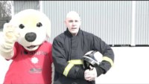
Stop Drop and Roll Video
Notes:
Full link to Stop Drop and Roll YouTube video https://youtu.be/O2iAO2651o8 with Closed Captions

Slide 10

Smoke Alarms
Does your home have working smoke alarms?
What is a smoke alarm and does your home have one on each floor?
You should test all your smoke alarms once a week to make sure they are working, by pressing the button in the middle until it beeps.
Be Cracker’s Fire Safety Hero and “test it Tuesday”.

Slide 11
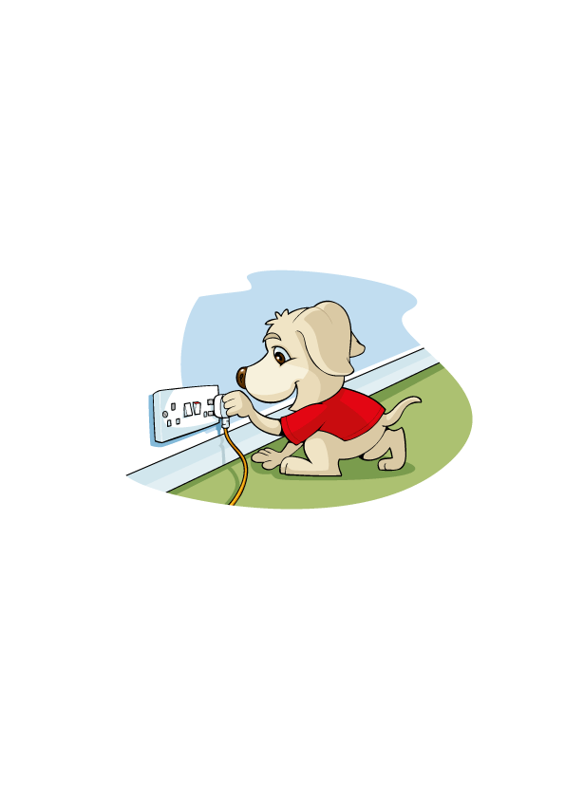
Bedtime Routines
What do you do before go to bed?
Remember to always -
Close all the inside doors, to stop a fire from spreading.
Turn off and unplug anything electrical, including TVs and computers. Not Fridges and Freezers!
Make sure an adult takes a charged phone to bed in case of an emergency, but do not leave it on charge.
Make sure exits and stairs are kept clear.
Keep your keys in a place near your front and back doors, where everyone knows where they are if there is an emergency.

Slide 12
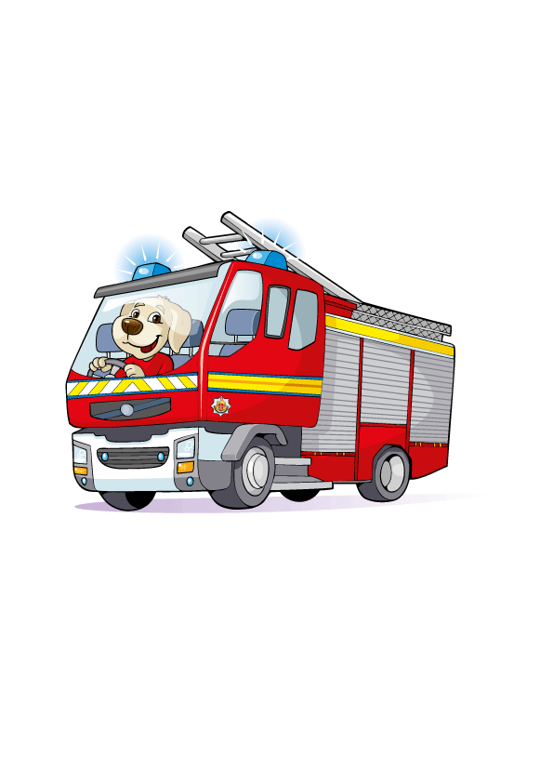
Escape Plans
What should you do if you hear a smoke alarm sounding?
Alert an adult and leave the house with them through your normal exit.
Do not go back for pets, toys, iPads etc.
Do not try to put the fire out yourself.
Get out, stay out and call 999!

Slide 13

What number do you call in an emergency?
Notes:
Full link to Learning To Call 999 YouTube video https://www.youtube.com/watch?v=kX2pwVxgtIQ&t=1s with auto generated captions

Slide 14
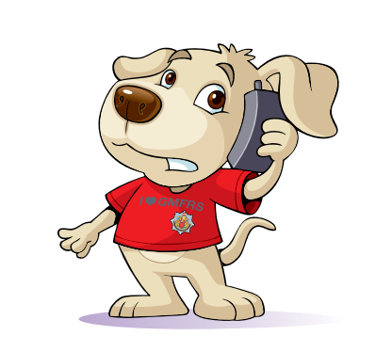
Calling 999
Don’t be afraid to call 999, if you’re unsure whether it’s an emergency, it’s better to be safe than sorry.
You don’t need any credit to call 999.
Give as much information as you can – for example, your address.

Slide 15
Why should you never try to put the fire out yourself?

Slide 16
Questions to recap…
What might start a fire in your home?
Can you remember the Firefighter’s poem?
What do you do if your clothes catch fire?
How often should you test your smoke alarms at home?
Name one thing you should do as part of your bedtime routine?
What should you do if you hear a smoke alarm sounding?
What number do you call in an emergency?

Slide 17
Thank you for having us!
Are there any questions?

